Slide 1
Ohm’s Law

Slide 2
What is Ohms law?
Formula electric potential difference between two points on a circuit (V) is equivalent to the product of the current between those two points (I) and the total resistance of all electrical devices present between those two points (R).
Basic formula in electronics.

Slide 3
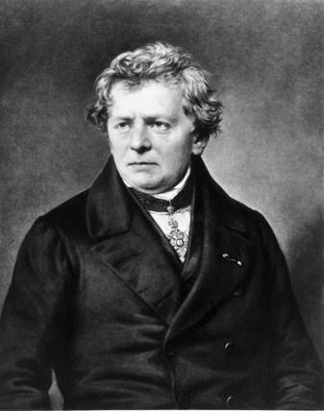
Georg Ohm
1789 - 1854
German physicist/mathematician
Begun own research on
electrochemical cell (device generates energy from chemical reactions) invented by Alessandro Volta
Discovered proportionality between the potential difference (voltage) applied across conductor , resulting in electric current.

Slide 4
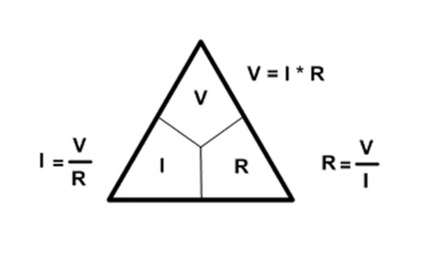
Ohms Law Equation
three variables: voltage, current, resistance
V = I * R (depending on which variable you are trying to solve for)

